Slide 1
Web Apps @ Scale
Let’s talk about Microservices, Containers and Clusters

Slide 2



Who am I?
Moim Hossain
Technical lead, Exact Software
@moimhossain
Github.com/moimhossain
www.moimhossain.com

Slide 3
Agenda
Background
What are Monoliths
What are Microservices?
Why?
Challenges
Containers
Docker swarm
Automation
Infrastructure as Code
Demo
Takeaways

Slide 4
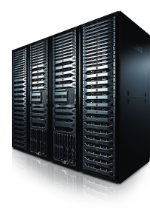
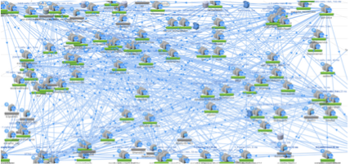
Background
Back in the days ( < 2008 )
Today
On-premise data center
Everything in one web package
Single WebApp package (.war)
Single Web Site on IIS (XL Deploy etc.)
Public Cloud data center (AWS, Azure, Google etc.)
100s of fine grained services
Source: Netflix services from internet

Slide 5
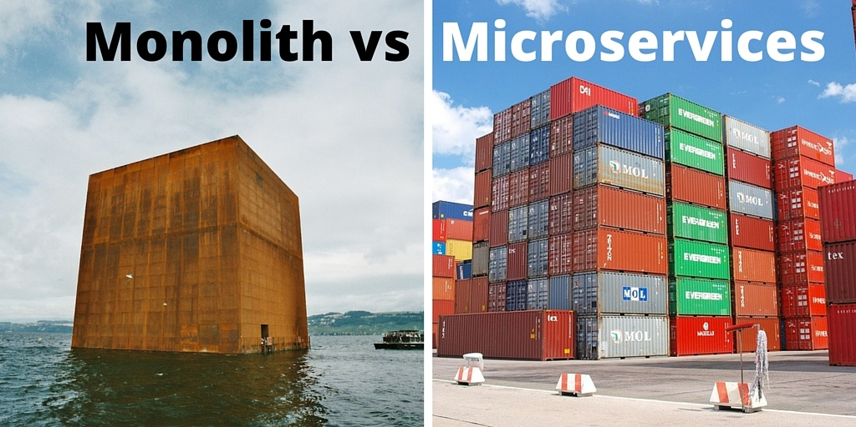
Monolithic Apps

Slide 6
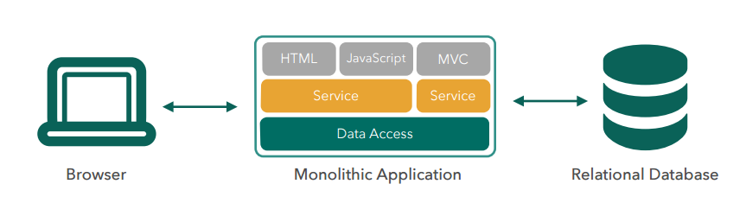
Monolithic architecture

Slide 7
Characteristics
Large codebase
Many components, no clear ownership
Long deployment cycles
Inefficient and typically expensive to scale
One component can hinder the availability
Intimidating to new developers
Requires long term commitment to Tech-Stack

Slide 8
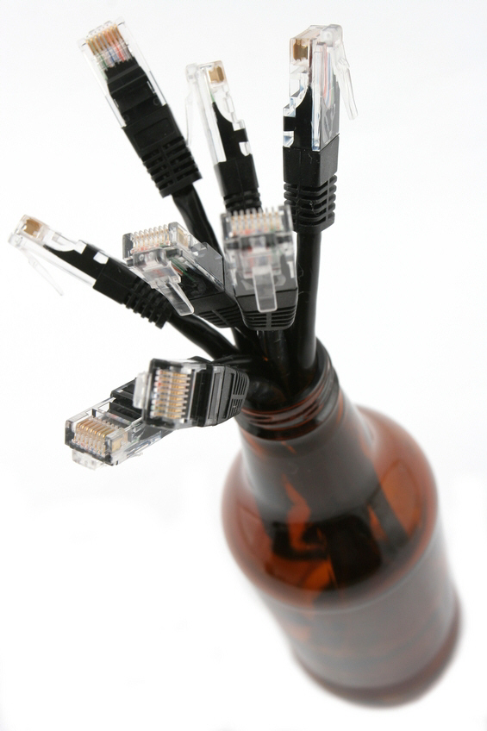
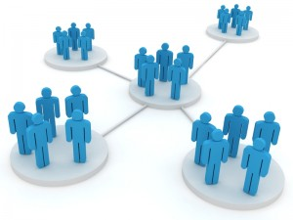
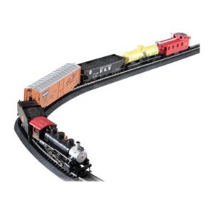
Evolution of Monoliths?
Tipping points
Bottleneck in
Monolithic stack
Diverse functionality
Organizational growth

Slide 9
Micro-services

Slide 10
Core concept: Service compositions
Write programs that do one thing and do it well.
Write programs to work together
Choreography over orchestration!

Slide 11
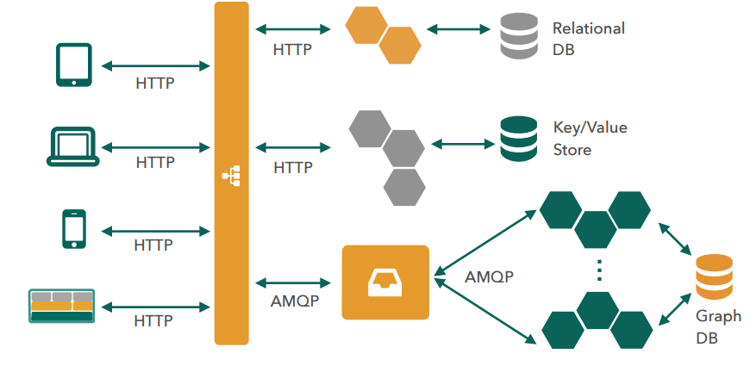
Microservice Architecture

Slide 12
Characteristics
Many smaller (fine grained), clearly scoped services
SRP (Single responsibility principle)
DDD (Domain Driven Design)
Independently managed
Clear ownership for each service
DevOps model adoption required (You build it, you run it)
Faster deployment cycles
Efficient and independent scaling
Failure of one service doesn’t affect total availability (Circuit breakers)
Faster adoption time for new team members
Unlocks Tech Stack preferences and polyglot persistence
Canary deployment and A/B testing

Slide 13
Challenges: Complexity
Distributed systems are inherently complex
Network latency
Fault tolerance
Retry storms
Service monitoring
Operation overhead (One platform team doesn’t work well)
DevOps model adoption required (You build it, you run it)
You Need a lot of automation!

Slide 14
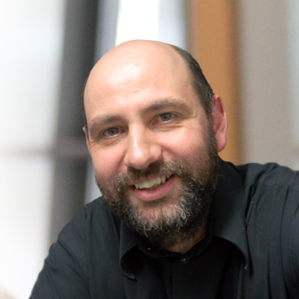
Pre-requisites
Rapid provisioning
Basic monitoring
Rapid Application deployment
DevOps culture
You must be this tall to use Microservices!

Slide 15
Containers to rescue?

Slide 16
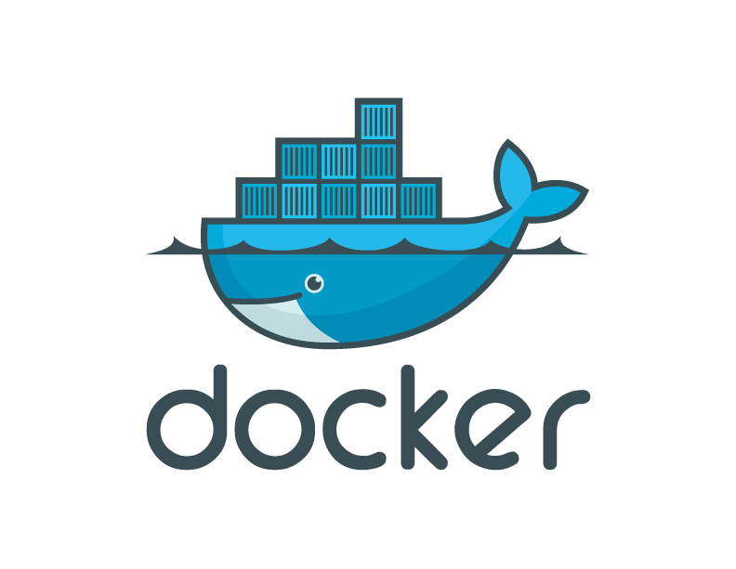
Docker introduction

Slide 17

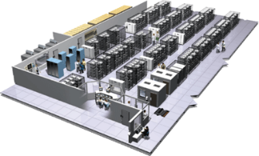
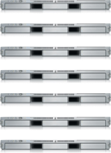
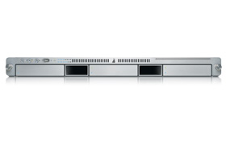
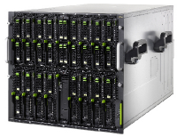

The challenge
User DB
Static website
sql
Queue
Analytics DB
nginx 1.5 + modsecurity + openssl + bootstrap 2
Do services and apps interact appropriately?
Redis + redis-sentinel
hadoop + hive
Multiplicity of Stacks
Background workers
Web frontend
net runtime + SQL + library A + nodejs + phantomjs
ReactJS + Rails + sass
API endpoint
ASP.net + Node Express
Production Cluster
Development VM
Public Cloud
Multiplicity of hardware environments
Can I migrate smoothly and quickly?
QA server
Disaster recovery
Customer Data Center
Production Servers
Contributor’s laptop

Slide 18
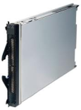
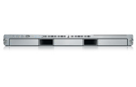


The Matrix from hell
? | ? | ? | ? | ? | ? | ?
? | ? | ? | ? | ? | ? | ?
? | ? | ? | ? | ? | ? | ?
? | ? | ? | ? | ? | ? | ?
? | ? | ? | ? | ? | ? | ?
? | ? | ? | ? | ? | ? | ?
Static website
Web frontend
Background workers
User DB
Analytics DB
Queue
 | Development VM | QA Server | Single Prod Server | Onsite Cluster | Public Cloud | Contributor’s laptop | Customer Servers

Slide 19
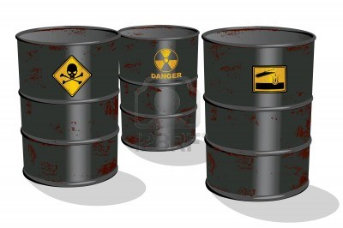
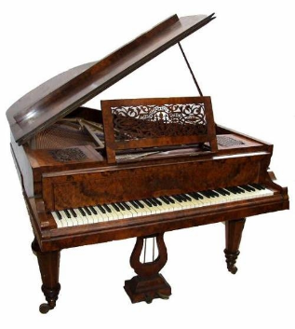

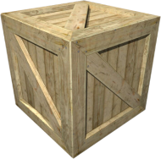
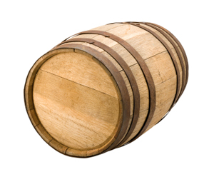
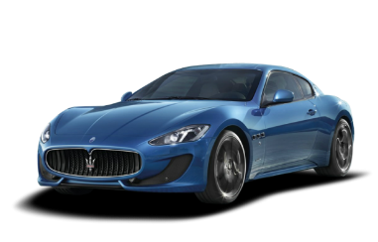
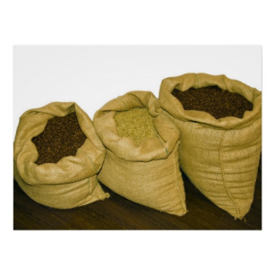



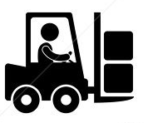
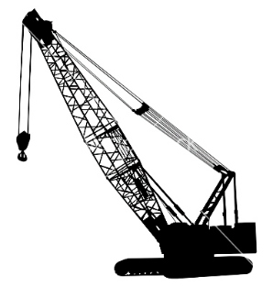
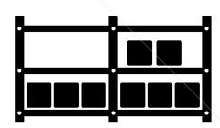

Cargo transport Pre-1960
Do I worry about how goods interact (e.g. coffee beans next to spices)
Multiplicity of Goods
Can I transport quickly and smoothly
(e.g. from boat to train to truck)
Multiplicity of methods for transporting/storing

Slide 20
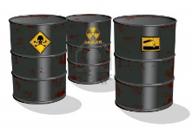

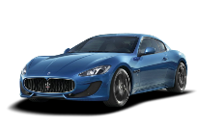


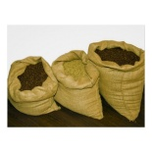


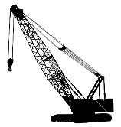



A matrix from hell – too?
 | ? | ? | ? | ? | ? | ? | ?
 | ? | ? | ? | ? | ? | ? | ?
 | ? | ? | ? | ? | ? | ? | ?
 | ? | ? | ? | ? | ? | ? | ?
 | ? | ? | ? | ? | ? | ? | ?
 | ? | ? | ? | ? | ? | ? | ?

Slide 21

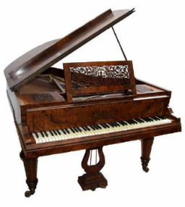

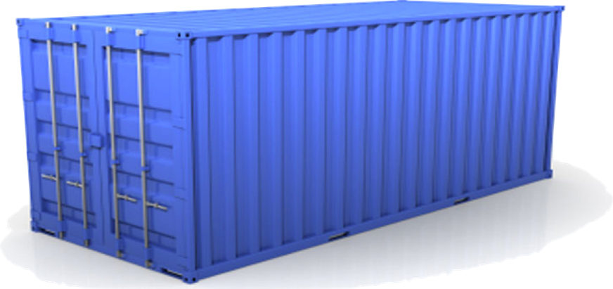
Solution: Shipping containers
Do I worry about how goods interact (e.g. coffee beans next to spices)
Multiplicity of Goods
A standard container that is loaded with virtually any goods, and stays sealed until it reaches final delivery.
…in between, can be loaded and unloaded, stacked, transported efficiently over long distances, and transferred from one mode of transport to another
Can I transport quickly and smoothly
(e.g. from boat to train to truck)

Slide 22
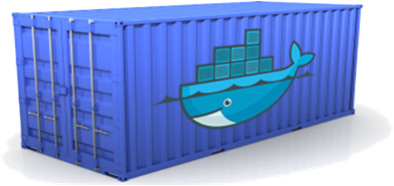
Docker is shipping container for software
Static website
User DB
Web frontend
Queue
Analytics DB
Do services and apps interact appropriately?
Multiplicity of Stacks
An engine that enables any payload to be encapsulated as a lightweight, portable, self-sufficient container…
…that can be manipulated using standard operations and run consistently on virtually any hardware platform
Can I migrate smoothly and quickly
Development VM
QA server
Customer Data Center
Public Cloud
Production Cluster
Contributor’s laptop

Slide 23
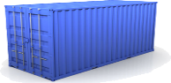
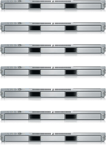
Docker eliminates the matrix from hell
Static website
Web frontend
Background workers
User DB
Analytics DB
Queue
 | Development VM | QA Server | Single Prod Server | Onsite Cluster | Public Cloud | Contributor’s laptop | Customer Servers

Slide 24
Why we (developers) care?
Make the entire lifecycle more efficient, consistent and repeatable
Eliminate inconsistencies between DTAP environments
Significantly improves the speed and reliability of CI/CD
Lightweight, costs, deployment and portability issues are way better than VMs.

Slide 25
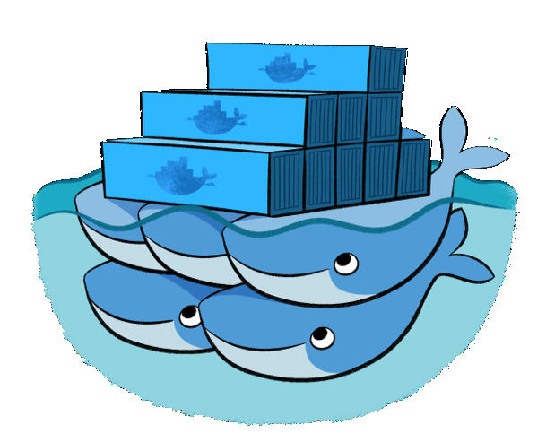
Docker swarm – Docker native clustering system

Slide 26
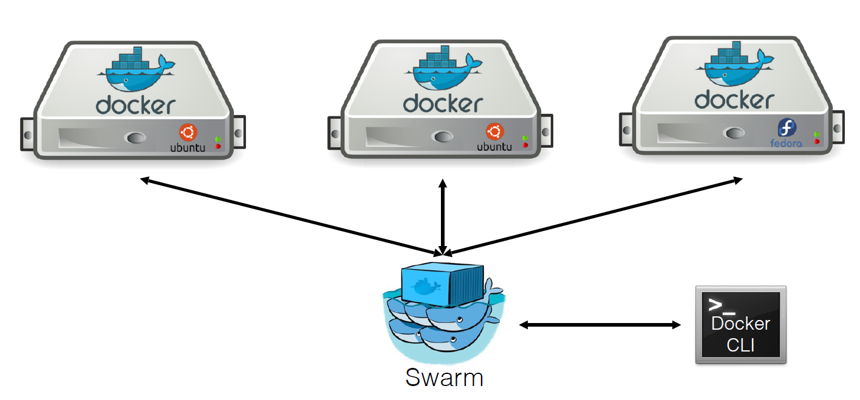
Docker swarm cluster

Slide 27
Swarm in a nutshell
Exposes several Docker engines as a single virtual machine
Serves the standard Docker API
Extremely easy to get started

Slide 28
Setup using the hosted discovery service
Create a cluster ($ swarm create)
Add nodes to a cluster ($ swarm join --add=<node_ip> token://<token>)
Start swarm ($ swarm manage --addr=<swarm_ip> token://<token>)

Slide 29
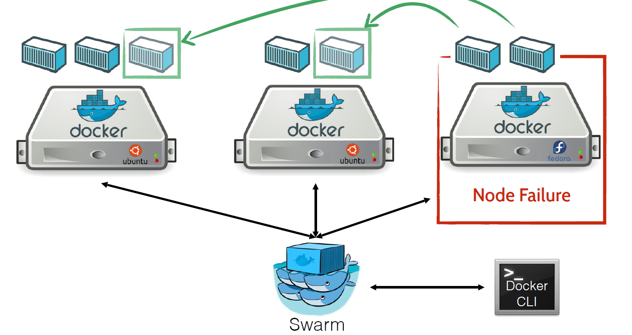
On-failure rescheduling

Slide 30
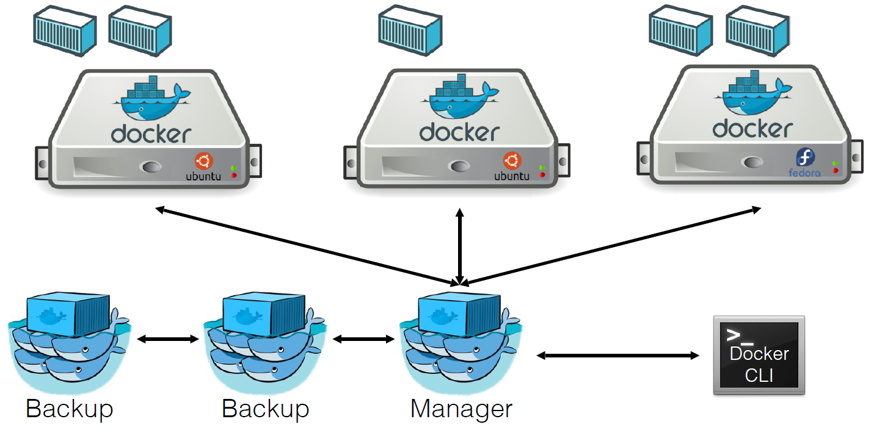
High-availability (manager backup instances)

Slide 31
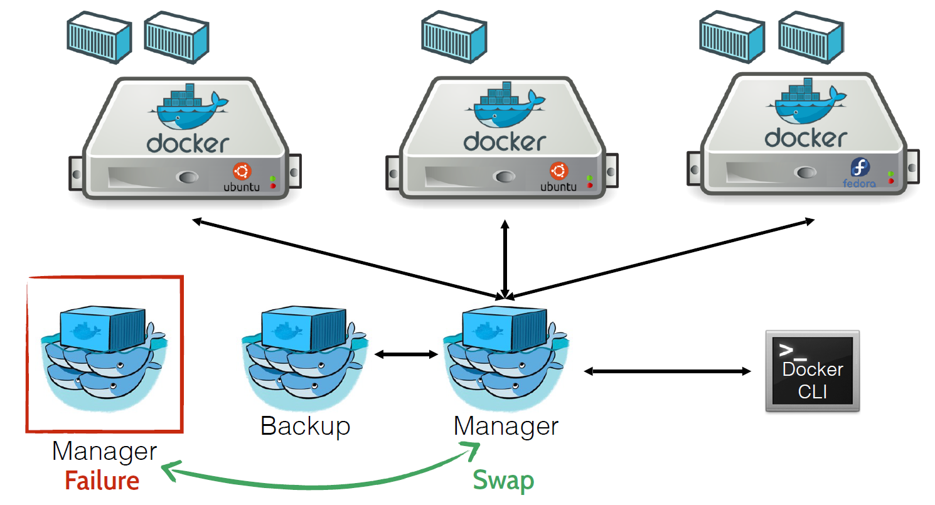
High-availability (manager backup instances)

Slide 32
High-availability (manager backup instances)

Slide 33
Infrastructure As Code

Slide 34
Infrastructure as code
Rapid provision with consistency
DTAP environments are easy to provision and always consistent
Manageable and serves as Living document of the infrastructure
Integrate CI/CD pipeline

Slide 35
Infrastructure as code
ARM Templates – Azure
CloudFormation – AWS
Terraform, Puppet, Chef and others

Slide 36
DEMO

Slide 37
Question time!
Thank you!

